Slide 1

Management of Small Business
Kateryna Zaslavska
Associate Professor
of Management, Logistics and Economics Department
of Simon Kuznets Kharkiv National University of Economics

Slide 2
What is “Business”?

Slide 3
What is “Business”?
An organization or economic system where goods and services are exchanged for one another
or for money. http://www.businessdictionary.com/definition/business.html

Slide 4
What is “Business”?
Business as a type of economic activity -
it's free activity (except forbidden by legislative acts), carried out by private persons, enterprises or organizations for the purpose of receiving income.

Slide 5
What is “Business”?
1. The form of economic responsibility of economic entities, aimed at achieving certain results in the economic field (profit, etc.).
2. Initiative, independent economic activity, carried out at the expense of own and borrowed funds and under its property responsibility, the main objectives of which are profit making and development of own business, as well as manufacturing of goods, performance of works, rendering of services.
3. The enterprise, firm or a set of enterprises, brings profit as a result of certain types of activities. As a rule, these are economically isolated small and medium enterprises, administratively independent of state and other institutions, oriented to the market, forming the structure and volume of production under the influence of consumer demand for goods and services.
4. Operations, trading operations.
5. Occupation of occupation of a person, an entrepreneur.
Dictionary of modern economic and legal terms

Slide 6
What is “Business”?
Business is a business practice of a company or an individual entrepreneur.
Business is the activity of citizens who own property and receive income from this activity.
Business is also the aggregate of relations between all its participants, forming a team of like-minded people for the purpose of obtaining income, profits, development of a firm, enterprise, organization.

Slide 7
What is entrepreneurship?
Entrepreneurship
Strategic thinking and risk-taking behavior that results in the creation of new opportunities for individuals and/or organizations.
Entrepreneurs
Risk-taking individuals who take actions to pursue opportunities and situations others may fail to recognize or may view as problems or threats.
Management Canadian Edition Schermerhorn  Wright
Copyright © 2007 John Wiley & Sons Canada, Ltd.

Slide 8
Entrepreneurship –
the process of starting, organizing, managing, and assuming the responsibility for a business

Slide 9

Entrepreneurship is
The independent, systematic
for own risk business activities,
economic activities carried out by the subjects (entrepreneurs) with the purpose of making profit and achieving social outcomes

Slide 10
Main Signs of Entrepreneurship
directness of activity;
independence of activity;
systematic;
legality;
business risk;
profit.

Slide 11

Entrepreneurial Opportunity and Success
An entrepreneurial opportunity is a desirable
and timely innovation that creates value for interested buyers and end users
Exciting entrepreneurial opportunities exist for those who recognize them.
However, a true opportunity exists only for those who have the interest, resources, and capabilities required to succeed.

Slide 12
Criteria for business size:
The number of employees
Turnover

Slide 13
The number of employees is the main criteria as it is:
inflation resistant – it is not affected by fluctuations in the purchasing power of the currency;
transparent - easily defined and understood;
comparable – it allows you to make a reliable comparison of size of enterprises in the same industry;
available – the data is easy to obtain.

Slide 14
Types of Enterprises in Ukraine
Type of Enterprise | Criteria
Micro | Annual return– up to 2 mln euro The average number of employees – up to 10 employees
Small | Annual return – from 2 to 10 mln euro The average number of employees – up to 50 employees
Medium | Annual return – from 10 to 50 mln euro The average number of employees – up to 250 employees
Large | Annual return – more than 50 mln euro The average number of employees – more than 250 employees

Slide 15
The criteria of qualitative demarcation of business entities is
a set of features of these entities,
the presence of which allows them to be attributed to a certain type, distinguishes from other types of economic and legal rights, capabilities, abilities and responsibilities.

Slide 16
Criteria for qualitative demarcation
The first criterion is the fact of belonging of a business entity to a number of legal entities;
The second criterion is the type (form) of ownership of the means of production on which business is based.
The third criterion is the targeting of profit. In accordance with this criterion, the subjects of entrepreneurial business, primarily business firms, are divided into commercial and non-commercial.
The fourth criterion is the degree of independence of the respective business enterprise;
The fifth criterion is the allocation of individuals and legal entities - residents and non-residents of Ukraine;
The sixth criterion is the form and nature of the management of the firm (internal firm management), established by the participants of the firm (authoritarian, collegial (democratic), bureaucratic;
the seventh criterion is the type of business that is the subject of the firm's activities (diversified firms, conglomerates);
The eighth criterion is the allocation of the entire mass of individuals and legal entities of firms that use the exclusive ("exclusive") rights to engage in any type of activity (special exporters, special importers of products).

Slide 17
Other criteria for qualitative demarcation
strategies,
types,
methods and forms of competition,
participation in business associations,
the degree of influence in society,
activity in the international market

Slide 18
Features of a Small Business
low in capital but high in labor intensity;
efficient in specialized skill or service;
succeeds in small, isolated or overlooked markets;
often operates in unstable markets;
closer to the market place;
owners are the workers;
capital comes from the owner or small group;
area of operation is small;
size of the enterprise is small in relation to the industry

Slide 19
The main competitive advantages of small business
mobility, ability to react quickly to changing market conditions, efficiency of development of new products and changes in production volumes within the limits of production possibilities;
low management costs;
high turnover of resources;
small-scale production, the possibility of increasing efficiency due to narrow specialization, technological flexibility of production processes;
low capital intensity, rapid return on investments, low operating and overhead costs of the enterprise;
the ability to maximize the mobilization of available resources, including the operational use of the achievements of scientific and technological progress (in the technical, economic, organizational, and informational spheres);
rational organization of the enterprise, due to maximum convergence of management, marketing and production process;
optimal opportunities for realization of motives and tendencies for entrepreneurial activity.

Slide 20
Systemic threats that cause instability of small business development
limited financial resources, difficulties in acquiring production space and equipment;
the lack of financial reserves and the threat of rapid bankruptcy;
too narrow a circle of suppliers, which in some cases may form an undesirable business dependence;
insufficient development of sales and after-sales service infrastructure;
location of resources and marketing markets, hence the limits for growth;
lack of a clear hierarchy of management;
low competitiveness of products, the production of which is important economies of scale, hence - competition from large enterprises;
high vulnerability to unfavorable economic (inflation, cyclical fluctuations, tax pressure, etc.) and noneconomic (pressure from the authorities, criminality) factors;
instability of incomes of enterprises and persons employed there;
social insecurity of workers, creating difficulties in hiring;
the high weight of the personality factor in management and production, which creates favorable conditions for "shadowing" and criminalization of enterprises;
insufficient methodological security (accounting, management, marketing, etc.), the lack of entrepreneurial skills and lack of entrepreneurship in most entrepreneurs.

Slide 21

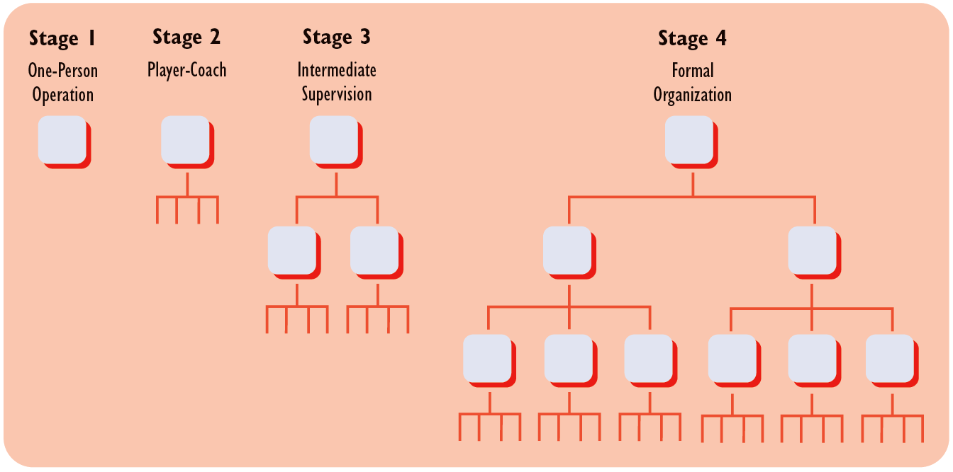
Organizational Stages of Small Business Growth
Source: © 2008 Cengage Learning. All rights reserved.

Slide 22

Stages in Firm Growth and Management
Growth Stage | Entrepreneur’s Workload
Stage 1. One-Person Operation | Doing all of the work. Making contact with customers.
Stage 2. Player-Coach | Continuing to do some of the basic work, although learning to hire and supervise.
Stage 3. Intermediate Supervision | Rising above hands-on management; working through intermediate managers.
Stage 4. Formal Organization | Using plans and budgets; following policies and procedures.
Source: © 2008 Cengage Learning. All rights reserved.

Slide 23
Managing Versus Doing
STAGE 1
STAGE 2
STAGE 3
STAGE 4
One-Person Operation
Player-Coach
Intermediate Supervision
Formal Organization
Time spent managing
Time spent doing
Source: © 2008 Cengage Learning. All rights reserved.

Slide 24
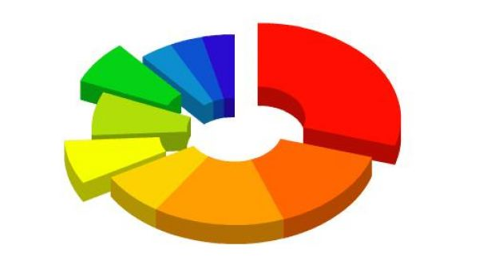
Business environment –
it is the totality of external
and internal factors that influence on the functioning of the firm
and requiring decisions
on their elimination or adaptation.

Slide 25
Business environment:
Internal;
External.

Slide 26

Internal Business Environment
Is the situational factors within the company:
goals,
structure,
technology;
people.

Slide 27

External Business Environment
Includes all the conditions and factors that occur in the environment, regardless of the activities of specific firms, but can have a significant impact on it and therefore require management decisions.

Slide 28

Thank you for attention!

